Slide 1
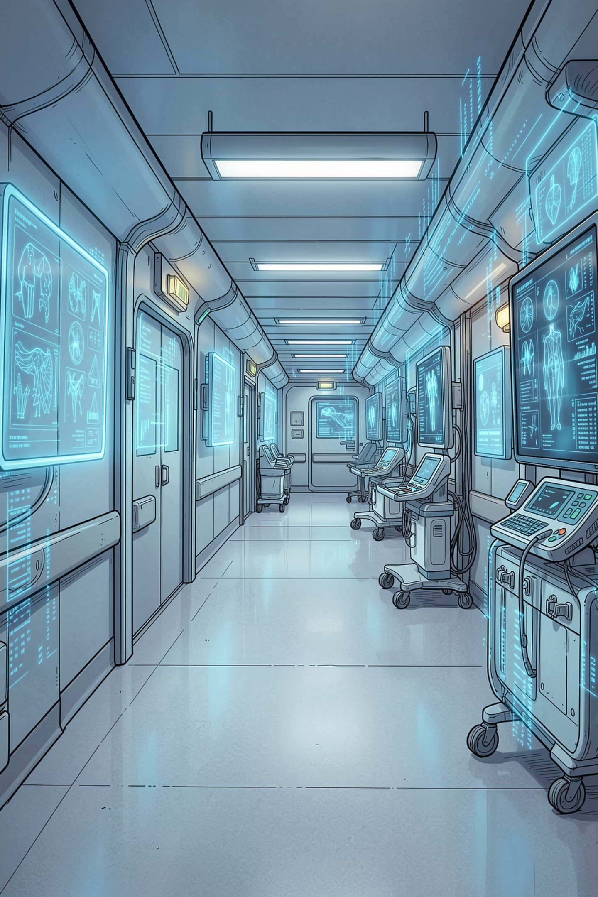
Data Science in Medical Field
AI, Machine Learning, and Healthcare Applications
HEALTHCARE + TECHNOLOGY

Slide 2


What Is Data Science?
Think of it as a recipe for making smart decisions — using information instead of guesswork.
📊 Data
🔍 Science
Facts and numbers collected from the real world
Finding hidden patterns in that information
💡 Decision
Using those patterns to make smarter choices
Collect Data
Analyze Patterns
Make Prediction
Better Decision
Example: A doctor uses past patient records to predict who might get sick next.

Slide 3
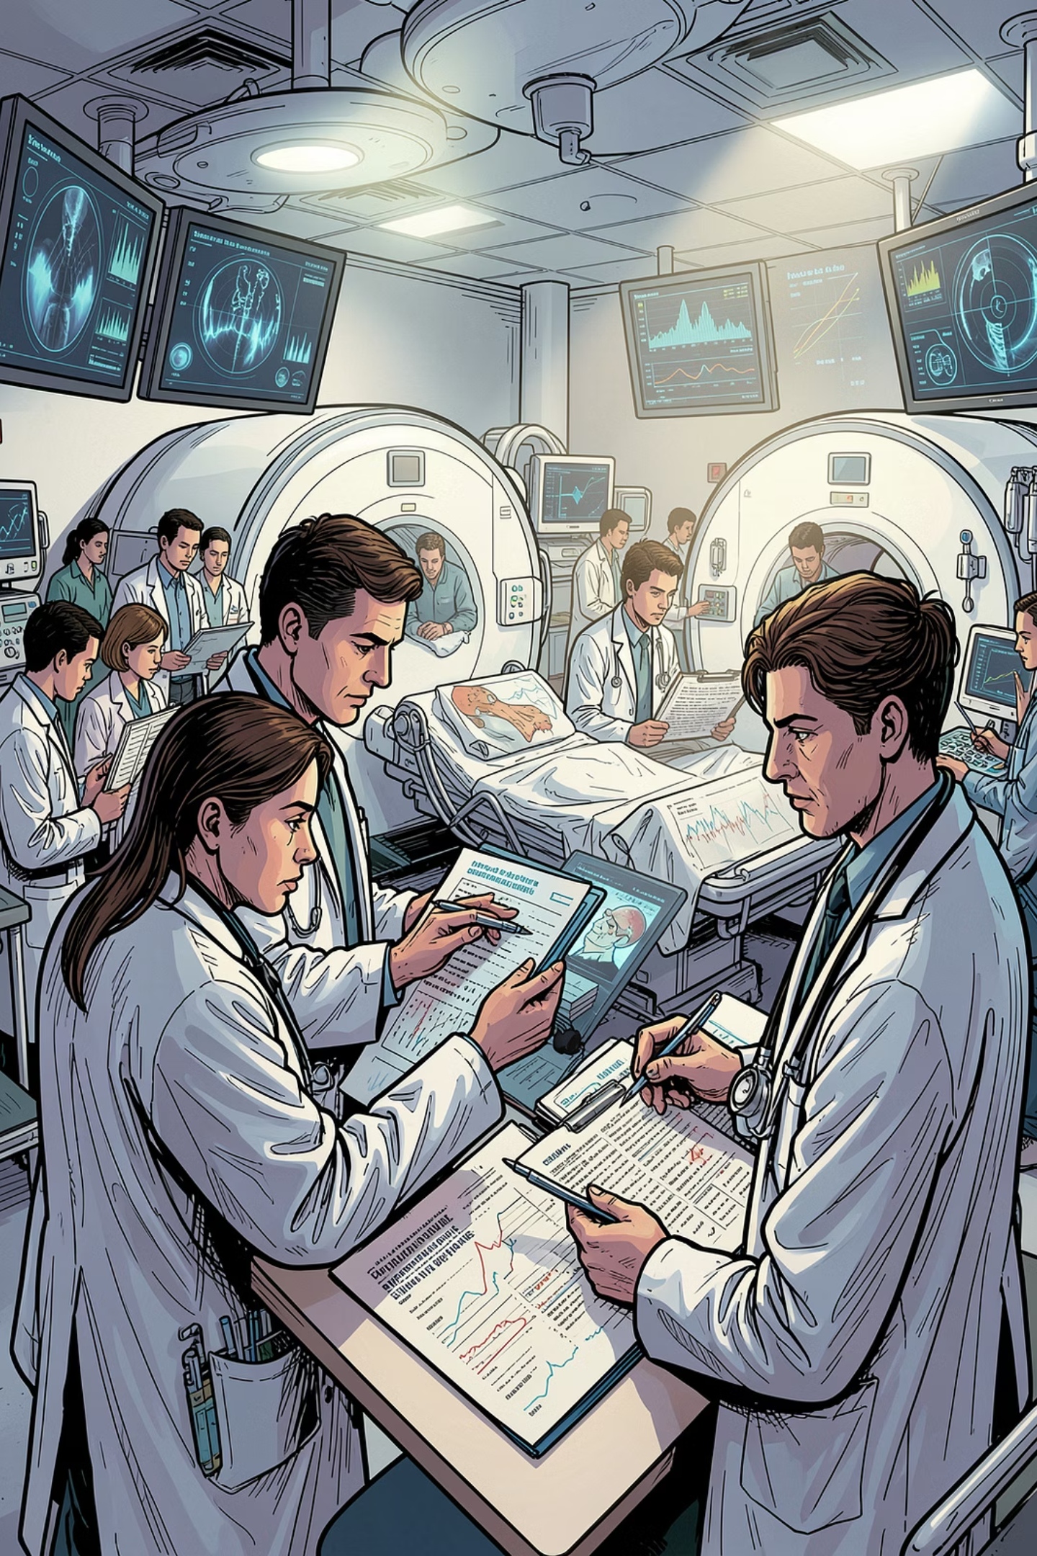
What Is Healthcare Data?
Hospitals generate massive amounts of data every single day. Data science helps make sense of it all.
Patient Records
History, age, and diagnoses
Lab Reports
Blood tests and results
Medical Images
X-rays, MRIs, CT scans
Wearable Data
Heart rate, sleep, oxygen levels

Slide 4
Why Do Hospitals Need Data Science?
Traditional healthcare has real challenges. Data science offers powerful solutions.
⚠️ The Problem
✅ The Solution
Too much patient data to manage manually
Slow diagnosis leads to delayed treatment
Human errors in records and prescriptions
Long waiting times for patients
Faster, more accurate diagnosis
Better, personalized treatment plans
Early disease prediction before symptoms appear
Smarter hospital management and staffing

Slide 5


Electronic Health Records (EHR)
An EHR is a digital version of a patient's medical file — replacing paper charts with smart, searchable records.
Doctor Enters
Store Records
AI Analyzes
Send Alerts
This workflow shows how patient information flows through an EHR system, enabling AI to spot patterns and alert doctors in real time.
What's Inside an EHR?
Real-World Systems
Age, weight, and blood pressure
Blood sugar and cholesterol levels
Prescriptions and allergies
Lab reports and imaging results
Epic Systems — used by major hospitals worldwide
Oracle Health — connects patient data across clinics
EHRs reduce paperwork errors and give doctors a complete patient history in seconds.

Slide 6
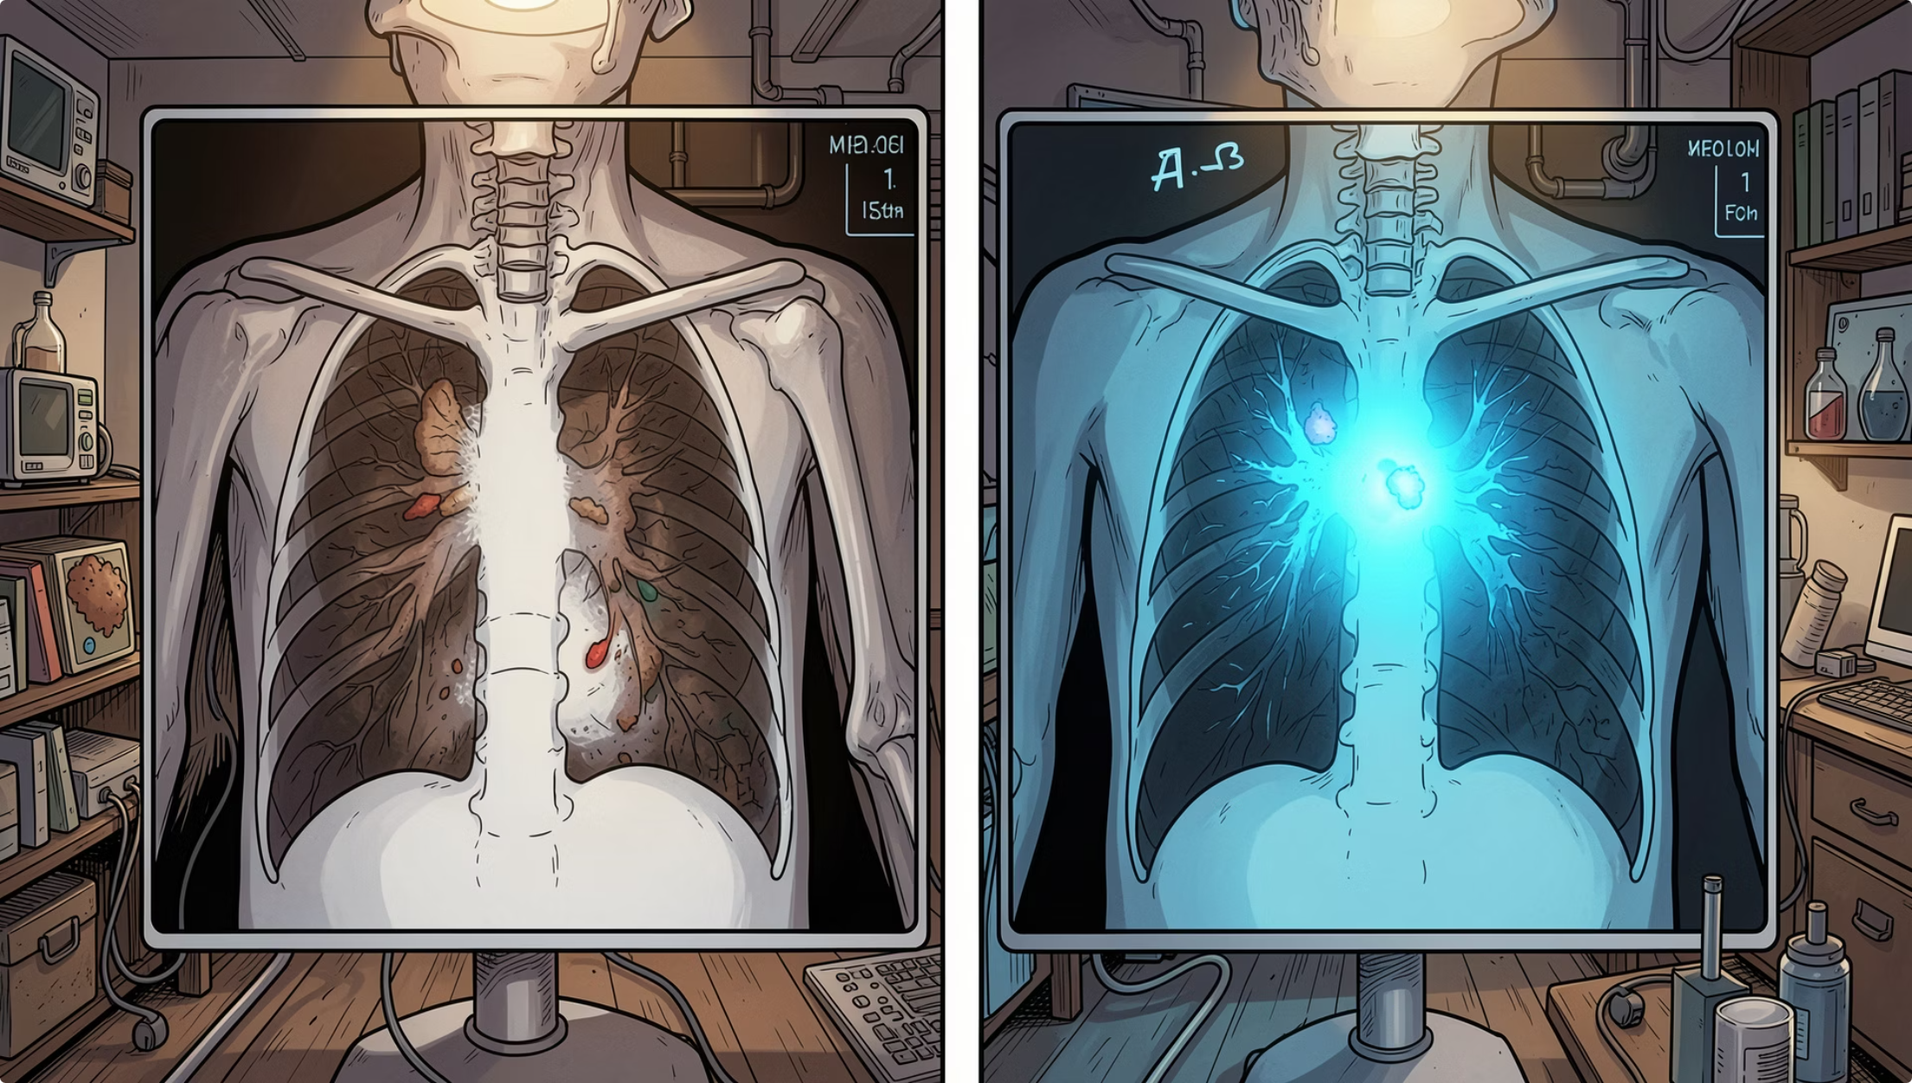

Medical Images and AI
AI can read medical scans faster and sometimes more accurately than the human eye — catching problems earlier.
What AI Analyzes
X-rays for fractures and infections
MRI scans for brain abnormalities
CT scans for tumors and organ issues
Real Applications
🫁 Lung infection detection (e.g., pneumonia, COVID-19)
🧠 Brain tumor identification
🦴 Bone fracture spotting
Google Health's AI detects breast cancer in mammograms with higher accuracy than radiologists.

Slide 7
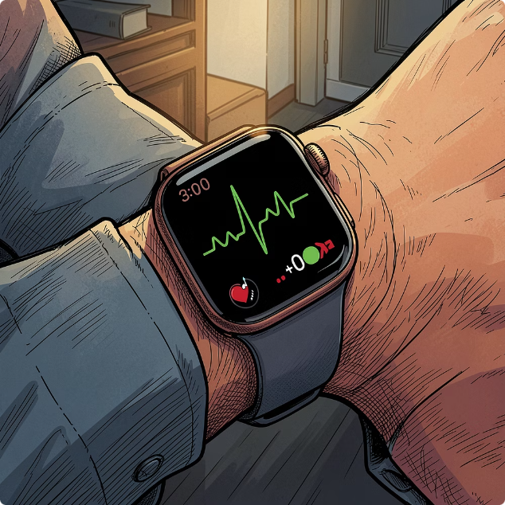
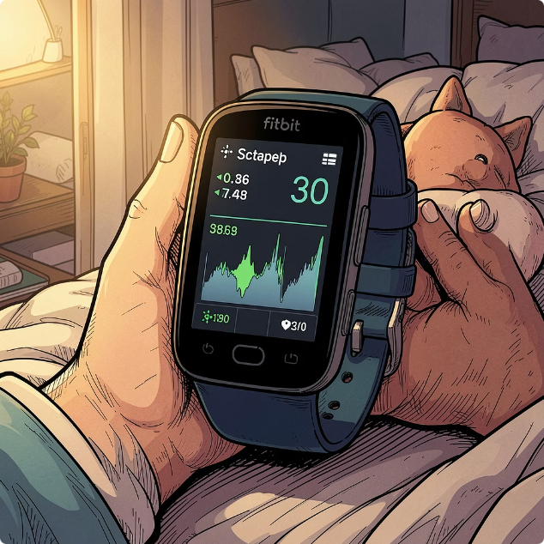
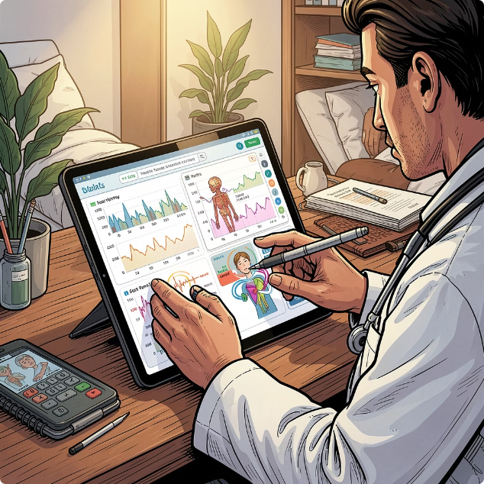
Wearable Devices and Health Monitoring
Smartwatches and fitness bands collect real-time health data — giving doctors a continuous window into your body.
Heart Rate & ECG
Sleep & Oxygen Tracking
Doctor Alerts
Detects irregular heartbeats and alerts users to possible cardiac issues
Monitors sleep quality and blood oxygen (SpO2) levels overnight
Abnormal readings are shared with healthcare providers in real time

Slide 8

Disease Prediction Using Data Science
AI studies patterns in patient data to predict diseases before symptoms appear — enabling early, life-saving intervention.
Patient Data
AI Model
Risk Prediction
This simple flow shows how patient information is fed into an AI model, which then calculates a risk score for conditions like diabetes or heart disease.
What AI Predicts
The Simple Idea Behind It
🩺 Diabetes — from blood sugar and lifestyle data
❤️ Heart Disease — from cholesterol and blood pressure
🫘 Kidney Disease — from lab test trends over time
AI combines your health numbers to calculate risk:
Translation: Your risk = a smart formula using your health data.

Slide 9
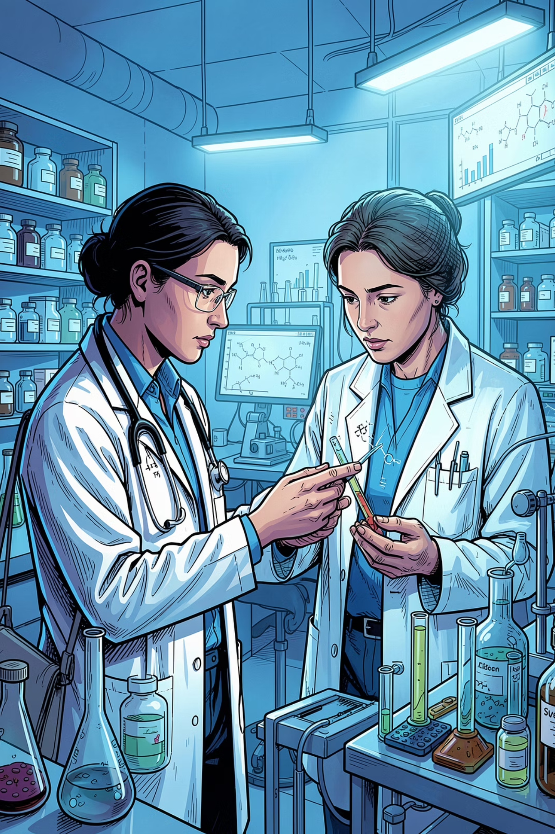

Drug Discovery and Personalized Medicine
Developing new medicines takes years and billions of dollars. AI is changing that — making drug discovery faster and smarter.
💊 Drug Discovery
AI analyzes millions of chemical compounds to find potential treatments — cutting discovery time from 10+ years to just a few years.
🧬 Personalized Medicine
Instead of one-size-fits-all, AI studies your genetics and medical history to recommend treatments that work best for you.
Companies like Moderna used AI to help design COVID-19 vaccine candidates in record time.

Slide 10
Real-World Impact and Key Takeaways
Data science is already saving lives in hospitals around the world.
30%
50%
40%
Faster Diagnosis
Fewer Errors
Cost Savings
AI reduces diagnostic time in radiology
Reduction in medication errors with smart systems
Estimated reduction in hospital operational costs
📊 Data = Information
🤖 AI = Pattern Finder
🏥 Healthcare = Better Outcomes
Every test, scan, and record is valuable data
Spots what humans might miss
Faster, safer, personalized care for everyone

Slide 11
ICU and Emergency Monitoring
AI acts as an extra pair of eyes in critical care, continuously analyzing patient data to prevent crises and alert medical staff.
Hospitals Monitor:
AI Predicts:
Heart rate
Blood pressure
Oxygen levels
Temperature
Sepsis onset
Cardiac arrest risks
Respiratory failure
Organ dysfunction

Slide 12
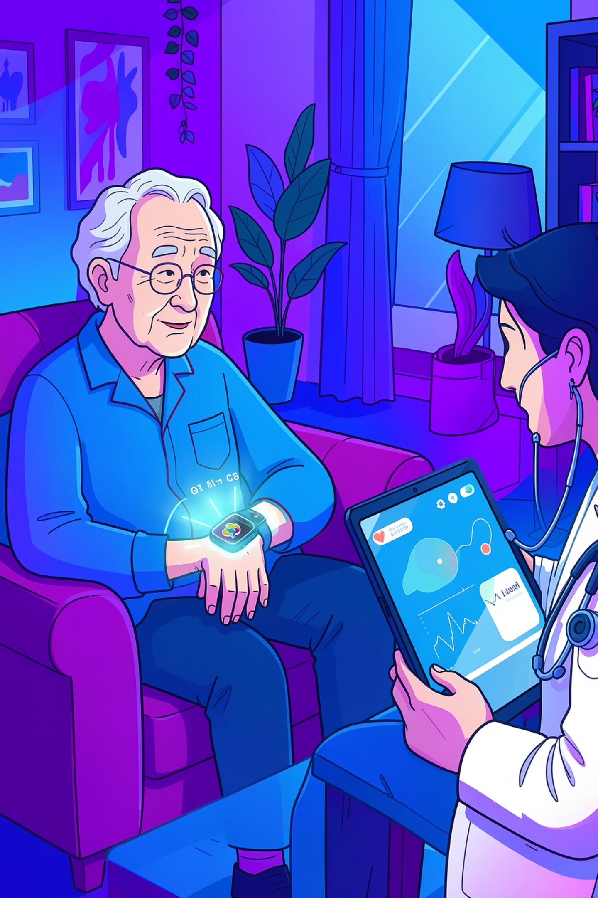
Remote Patient Monitoring
Data science extends care beyond hospital walls, allowing doctors to monitor patients from the comfort of their homes using connected devices.
Elderly Care: Ensuring safety and health for seniors living independently.
Chronic Disease Management: Tracking conditions like diabetes or heart disease to prevent complications.
Emergency Alerts: Automatically notifying caregivers or emergency services in case of critical events.
Smart Device
Collects real-time vital signs and activity data.
Cloud Transmission
Securely sends data to a centralized, accessible platform.
Doctor Review
Medical staff analyze trends and receive automated alerts.

Slide 13
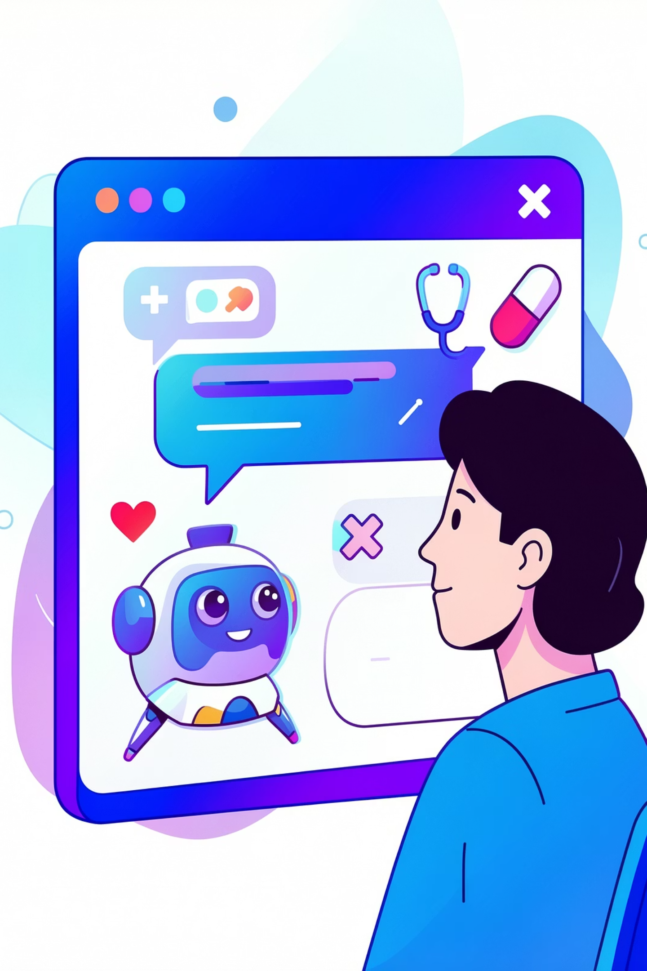

AI Chatbots in Healthcare
AI-powered chatbots are transforming patient interactions, providing instant support and automating routine tasks.
Appointment Booking
Easily schedule, reschedule, or cancel appointments 24/7.
Symptom Checking
Provide preliminary health assessments and guide patients to appropriate care.
Medicine Reminders
Send timely prompts to take medications and manage prescription refills.
These chatbots leverage Natural Language Processing (NLP) to understand and respond to human language effectively.

Slide 14
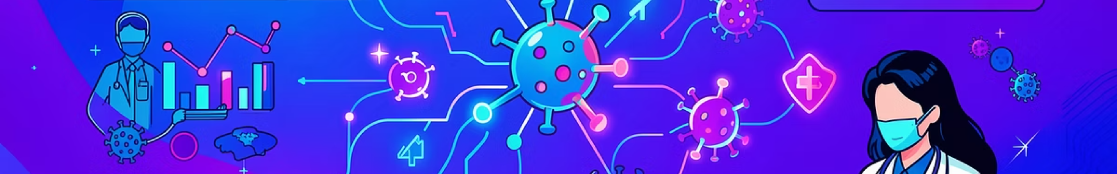

Pandemic Prediction and COVID-19
During the COVID-19 pandemic, data science became an indispensable tool, providing insights that guided public health responses and accelerated the fight against the virus.
ANALYTICS
BIOTECH
LOGISTICS
Case Prediction
Vaccine Analytics
Hospital Resource Planning
Data models forecasted infection rates, helping governments implement timely lockdowns and allocate resources.
AI analyzed trial data, accelerating vaccine development and identifying effective distribution strategies.
Predictive analytics optimized bed capacity, ventilator availability, and staffing levels in overwhelmed healthcare systems.
These data-driven approaches were critical in understanding disease spread and mitigating the pandemic's impact globally.

Slide 15
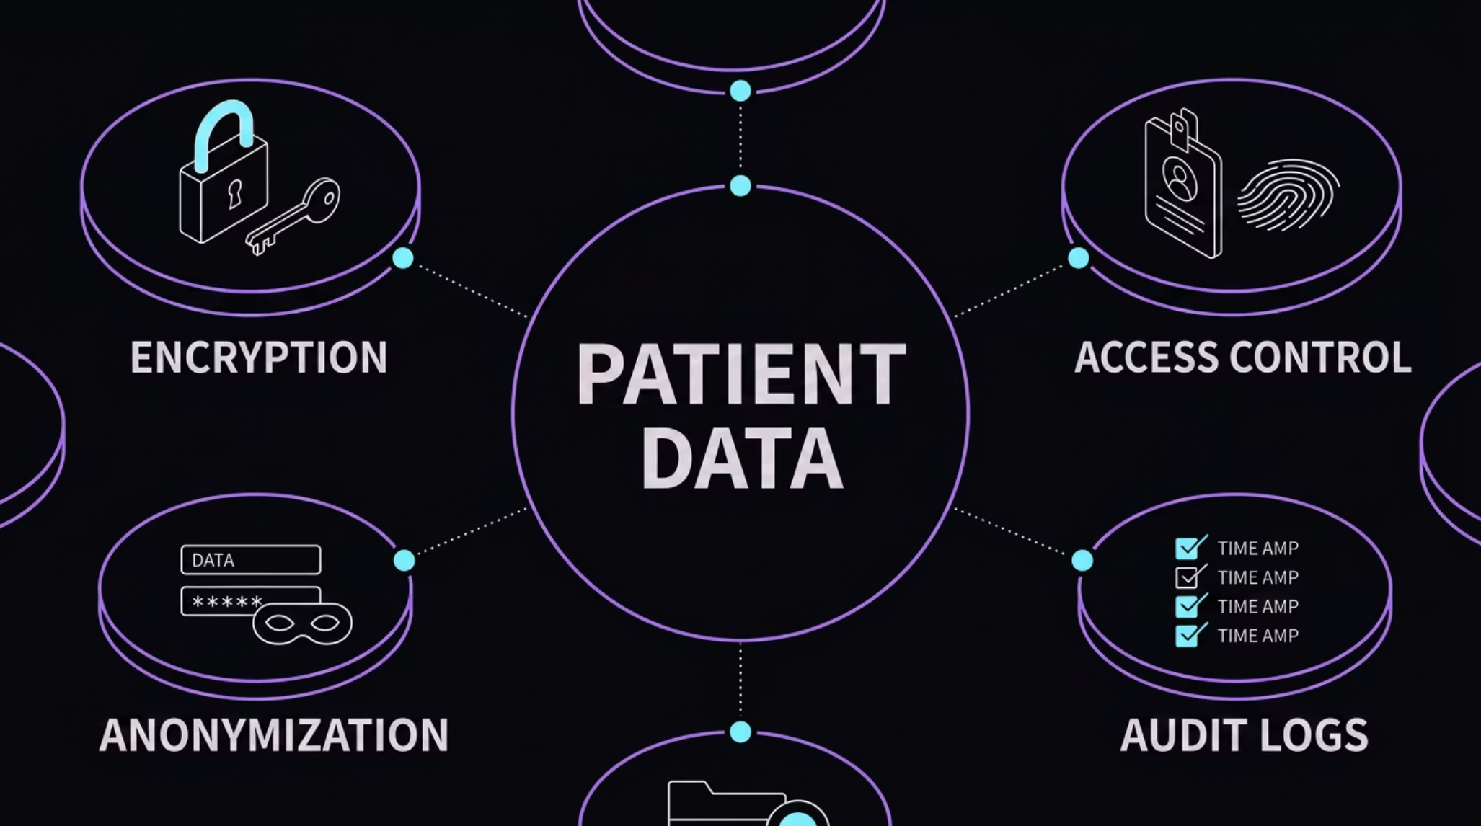

Data Privacy and Security
Patient information is incredibly sensitive, making its protection paramount in healthcare data science.
This multi-layered approach ensures that personal health information remains confidential and secure from unauthorized access or breaches.
Privacy Protection
Data Encryption
Secure Access
Implementing strict policies to govern how patient data is collected, stored, and shared.
Transforming data into a secure code to prevent unauthorized access, both in transit and at rest.
Ensuring only authorized personnel can access specific patient records, often with multi-factor authentication.
Data Anonymization
Removing personally identifiable information from datasets to protect individual privacy while allowing for analysis.
Key regulations like HIPAA (Health Insurance Portability and Accountability Act) and GDPR (General Data Protection Regulation) mandate stringent standards for protecting patient data.

Slide 16
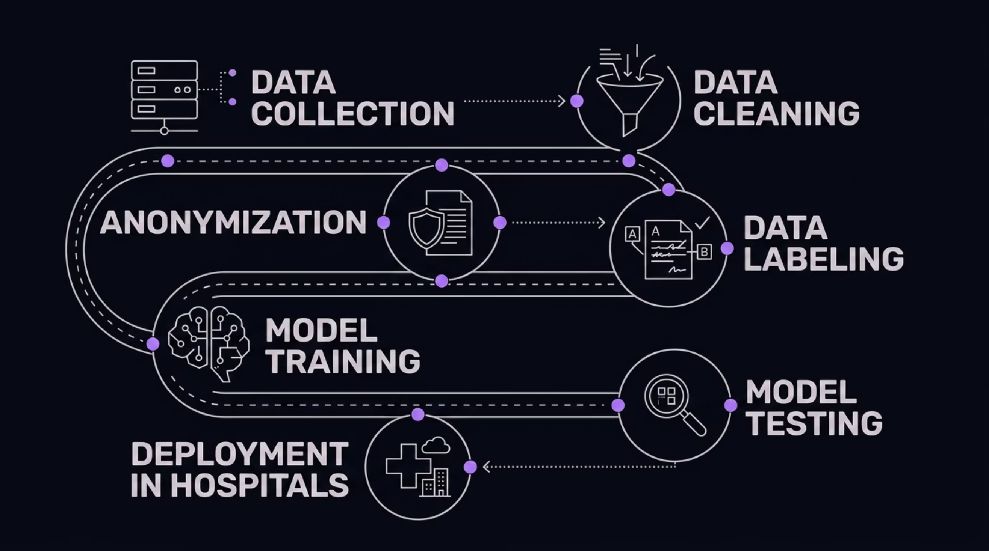

How AI Models Are Trained on Patient Data
Training AI to understand medical data is a multi-step process, transforming raw information into intelligent models ready to assist healthcare professionals.
This pipeline illustrates how patient data is systematically processed, from initial collection to becoming a deployed AI tool in a hospital setting.
.

Slide 17

Real-World Scenario: Diabetes Prediction
Let's consider a practical example of data science in action: predicting the risk of diabetes.
Hospitals collect various types of patient data, including:
Age
Weight (or BMI)
Sugar levels (blood glucose)
Exercise habits
Family history
AI models analyze these factors to identify patterns and predict an individual's likelihood of developing diabetes. This proactive approach allows for early intervention.
AI Analysis
Risk Assessment
Process features using predictive models.
Estimate diabetes risk scores per patient.
Data Collection
Personalized Intervention
Gather patient vitals and lab results.
Recommend tailored care and monitoring plans.
If the AI identifies a high risk, the system can trigger personalized recommendations:
Lifestyle changes, such as dietary adjustments and increased physical activity, are recommended.
Early treatment options can be explored with medical professionals, potentially preventing or delaying the onset of Type 2 diabetes.

Slide 18
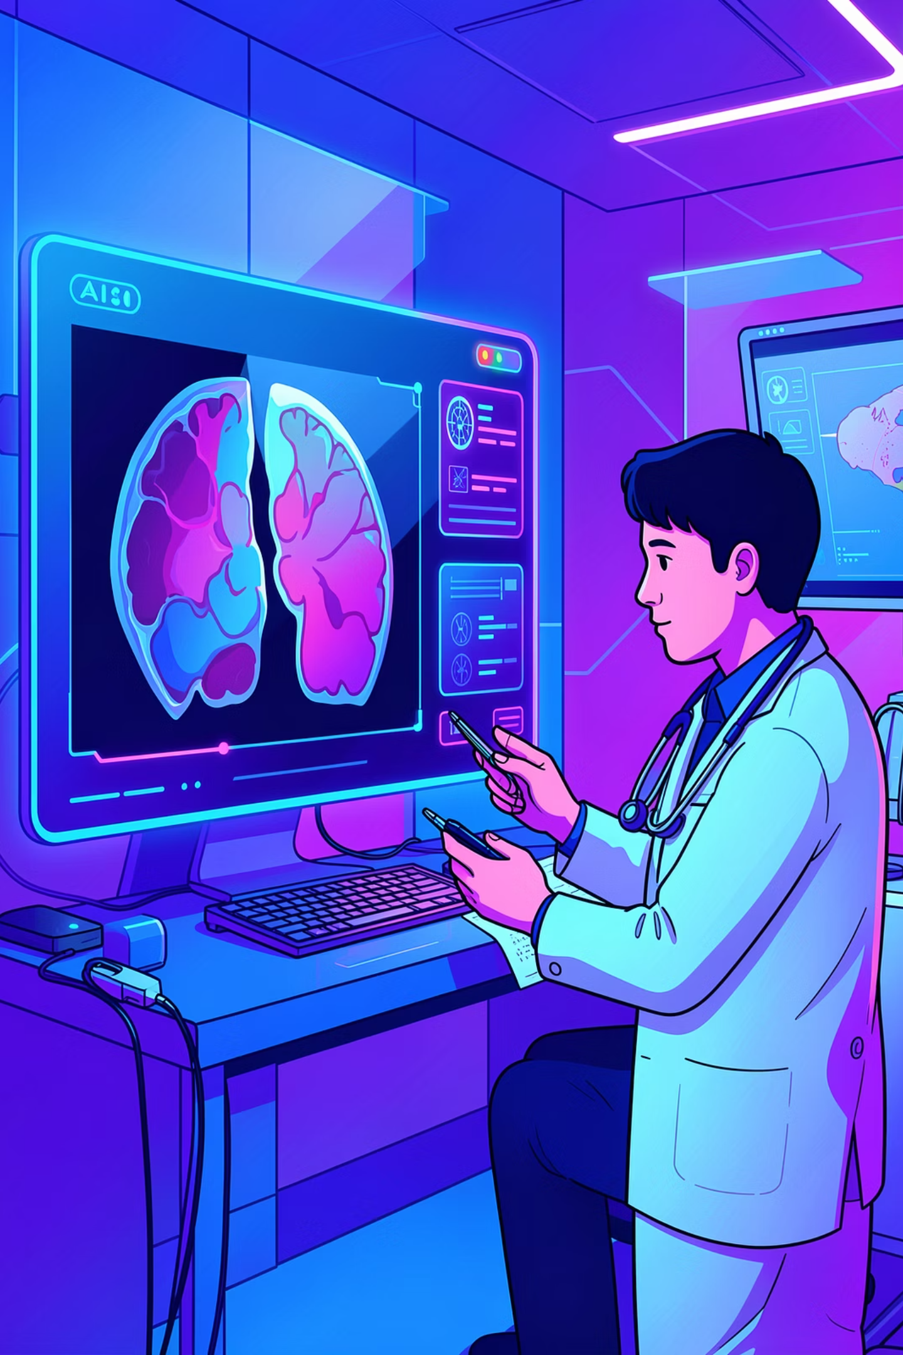
Real-World Scenario: Cancer Detection
Artificial Intelligence is transforming cancer screening by assisting radiologists in interpreting complex medical images like mammograms, leading to more timely and accurate diagnoses.
01
02
AI Analyzes Mammograms
Highlights Suspicious Regions
Advanced algorithms process high-resolution mammogram images, sifting through vast datasets to identify subtle patterns and anomalies.
The AI system pinpoints potential areas of concern, drawing the radiologist's attention to regions that might be indicative of cancerous growth.
03
Doctors Verify Results
Radiologists leverage AI's insights as a powerful second opinion, confirming findings and making final diagnostic decisions with enhanced confidence.
Key Benefits:
Faster Detection
Reduces the time required to review scans, allowing for quicker diagnostic workflows and patient feedback.
Better Accuracy
Improves the precision of identifying cancerous lesions, potentially catching what human eyes might miss and reducing false positives.
Early Diagnosis
Facilitates intervention at the earliest possible stages, significantly enhancing treatment efficacy and patient survival rates.

Slide 19
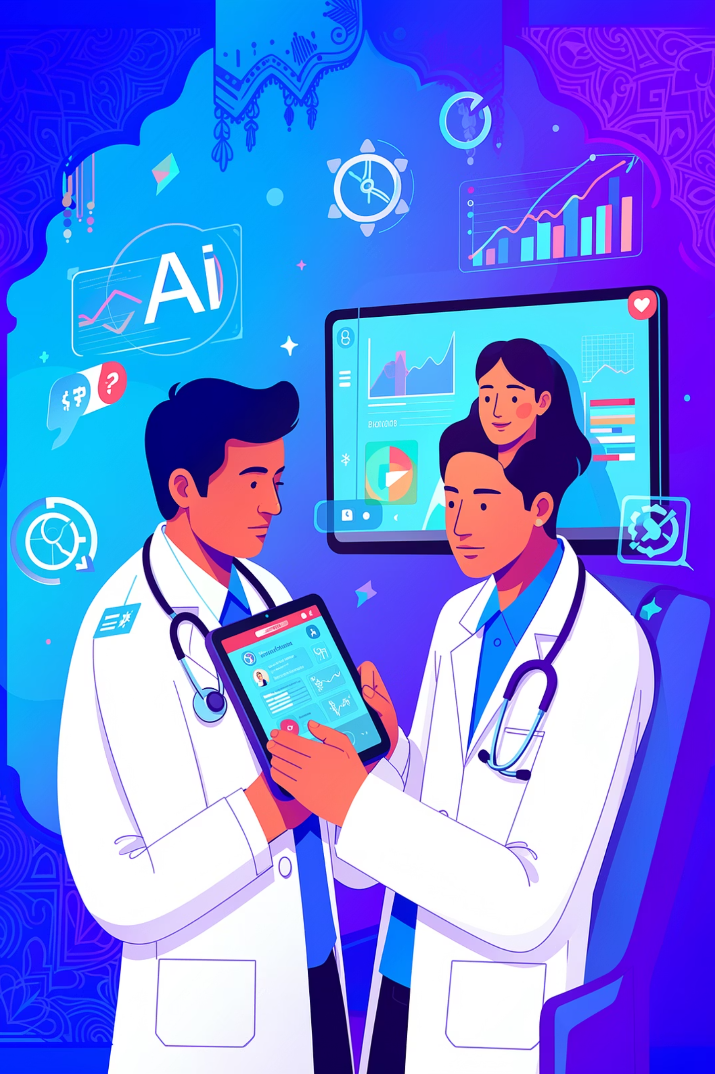
Data Science in Indian Healthcare
Data science is rapidly transforming India's healthcare landscape, addressing unique challenges from urban hospitals to remote villages through innovative technological solutions.
GOVERNMENT INITIATIVE
Ayushman Bharat
This national health protection scheme leverages data science for efficient beneficiary identification, fraud detection, and health service delivery optimization, impacting millions.
DIGITAL OUTREACH
Telemedicine in Rural India
Data-driven platforms connect remote patients with specialists, using predictive analytics to manage health trends and allocate resources in underserved areas.
HOSPITAL INTEGRATION
AI in Indian Hospitals
Leading institutions like Apollo Hospitals use AI for predictive diagnostics, operational efficiency, and personalized treatment plans, improving patient outcomes.
STARTUP INNOVATION
Healthcare Startups Using AI
Companies such as Practo utilize AI for appointment booking, online consultations, and managing electronic health records, enhancing accessibility and patient experience.

Slide 20
Challenges & Ethical Considerations
Patient data is very sensitive and must be kept private and secure.
AI systems can give wrong predictions if the medical data is incomplete or biased.
Doctors need to understand how AI makes decisions before trusting the results.
Collecting and managing large healthcare datasets is difficult and expensive.
AI should support doctors in treatment, not completely replace human medical experts.

Slide 21
The Future of Data Science in Healthcare
AI will help doctors diagnose diseases faster and more accurately.
Smart hospitals will use real-time data for better patient care and management.
Personalized medicine will provide treatments based on a patient’s DNA and health history.
Wearable devices and remote monitoring will improve healthcare from home.
Robotics, AI assistants, and predictive analytics will transform the future of medical treatment.

Slide 22
Conclusion:
Transforming Healthcare with Data Science Data Science is transforming healthcare by helping doctors, hospitals, and researchers make faster and smarter decisions using data, AI, and machine learning. It improves disease prediction, medical imaging, personalized treatment, patient monitoring, and hospital management. By analyzing large amounts of medical data, healthcare systems can provide earlier diagnosis, better treatments, and improved patient care. Although there are challenges related to privacy, security, and ethics, the future of Data Science in healthcare is highly promising and will continue to revolutionize modern medicine.

